Slide 1

Post-Paris Agreement Decoupling
A Data-Driven Assessment of GDP Growth & Greenhouse Gas Emissions

Slide 2

Introduction: Environmental Economics
This report analyses the evolution of territorial CO₂, CH₄, and N₂O emissions alongside GDP growth for major emitters between 1970–2015 and 2016–2024. We use IEA/EDGAR emissions data and World Bank GDP growth data.
1
2
Emissions Evolution
GDP Co-movement
How have CO₂, CH₄, and N₂O emissions evolved for major economies over 1970–2015 versus 2016–2024, in respect to the Paris Agreement?
How strongly does GDP annual growth co-move with CO₂, CH₄, and N₂O emissions growth over these two periods?
3
Post-Paris Decoupling
Does the GDP per capita–emissions relationship appear weaker after the Paris Agreement, indicating partial decoupling?

Slide 3
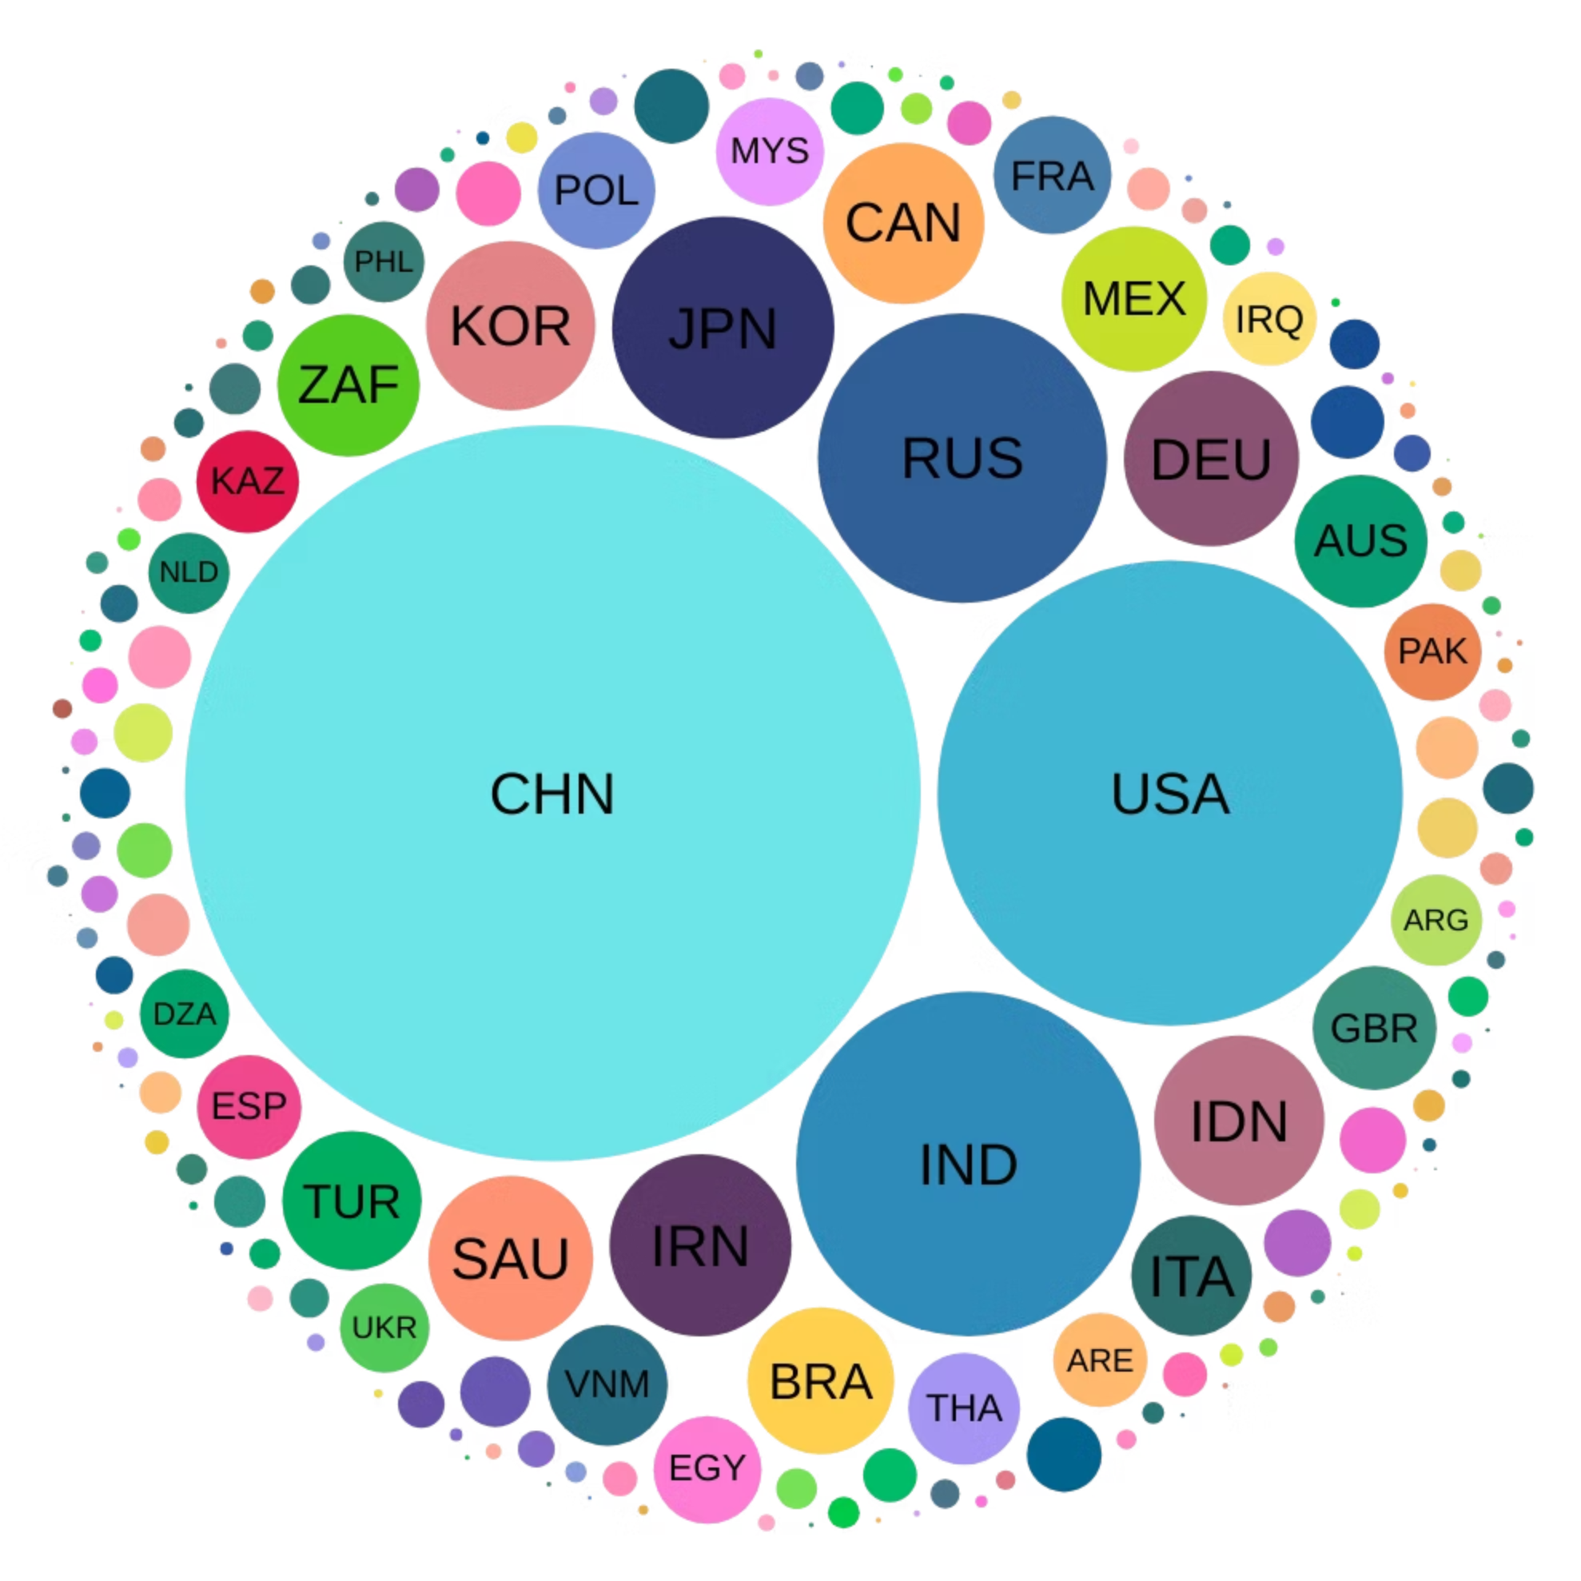

Data Significance & Relevance
Territorial CO₂, CH₄, and N₂O emissions are primary drivers of anthropogenic climate change. Long-run emissions series combined with GDP growth provide an empirical basis to study whether economic development has become less carbon intensive.
Climate Goals
Key indicators for tracking progress towards the Paris Agreement's 2°C temperature goals.
Empirical Basis
Studying if economic development has become less carbon-intensive, central to decoupling debates.
Global Impact
Chosen countries are major contributors to emissions, global GDP, energy use, and population.
Policy Insights
Assessing the Paris Agreement's effectiveness and informing policy on burden-sharing and transition speed.

Slide 4
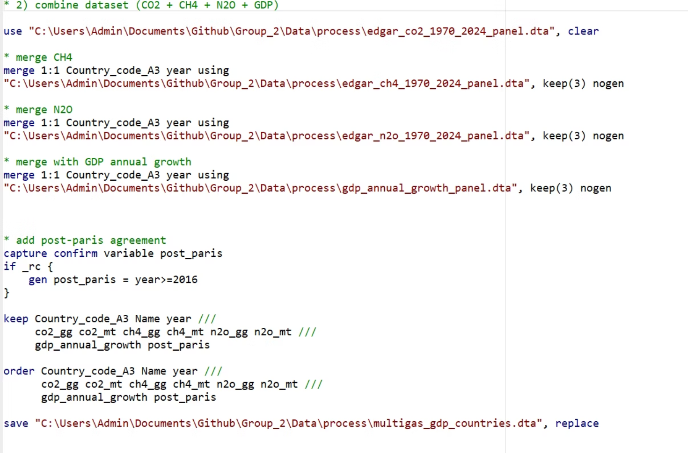
Technical Implementation: Data Sources
This statistical analysis was conducted using Stata/MP 19.0. We used the Emissions Database for Global Atmospheric Research (EDGAR) for annual country-level time series on CO₂, CH₄, and N₂O emissions (1970–2024).
For economic data, we utilised the World Bank World Development Indicators (WDI), specifically GDP per capita (annual % growth) for the same countries and years. These sources were merged by country code and year to construct a balanced panel.
Our workflow was organised into Stata do-files for reproducibility: import & cleaning, merge, ranking, summarise, decoupling, and visualise. A master file allows re-running the entire workflow.

Slide 5
Data Preparation & Management
Raw EDGAR Excel files for CO₂, CH₄, and N₂O emissions (1970–2024) posed import challenges due to multiple header rows and explanatory notes. We identified exact data ranges and used Stata's `cellrange()` and `firstrow` options for accurate import.
Variable Harmonisation
Renamed variables and standardised formats for consistent analysis.
Unit Conversion
Converted emissions from gigagrams (Gg) to megatonnes (Mt) by dividing by 1,000 (1 Gg = 0.001 Mt).
Dataset Merging
Combined cleaned datasets into a single harmonised panel linking emissions and economic variables at the country-year level.
Post-Paris Indicator
Generated an indicator for the post-Paris Agreement period (after 2016) to distinguish observations.

Slide 6
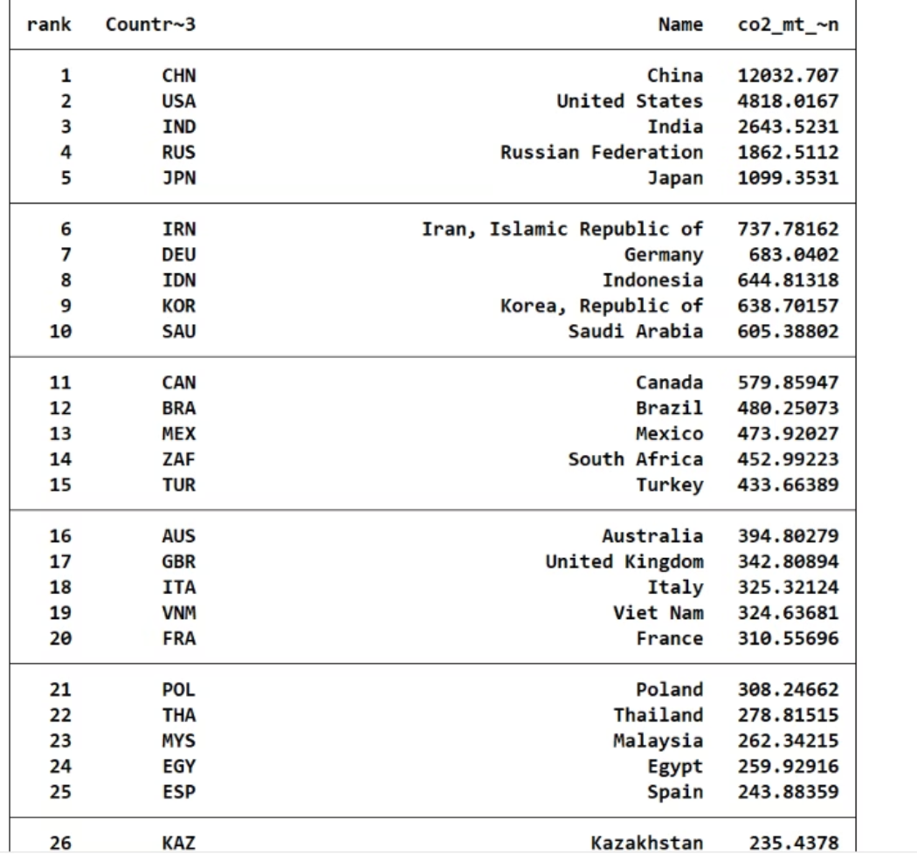
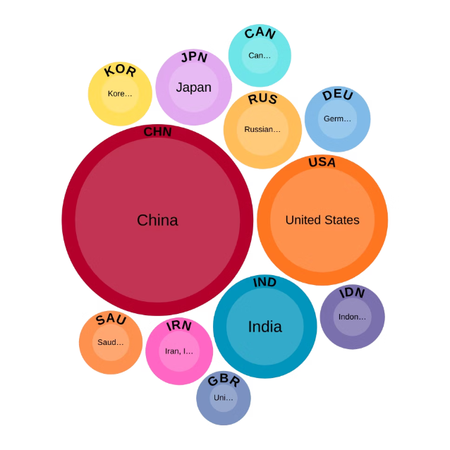
Country Sample Selection
We selected a country sample transparently by computing average CO₂ emissions over a chosen reference period and ranking all countries. The 11 largest emitters were chosen as a core group, capturing a substantial share of global emissions and diverse economic structures.
The United Kingdom was manually added as a twelfth sample due to its relevance for this class. This list of 12 countries was saved and used as a filter for the analysis.
China
United States
India
Russian Federation
Japan
Iran, Islamic Republic of
Germany
Indonesia
Korea, Republic of
Saudi Arabia
Canada

Slide 7

Decoupling Analysis: Methodology
We created absolute and relative decoupling indicators for CO₂ and CH₄ at the country-year level. These indicators help assess progress towards decoupling economic growth from greenhouse gas emissions.
Absolute Decoupling
Relative Decoupling
GDP grows while emissions fall. This represents a significant achievement in environmental policy.
Both GDP and emissions grow, but emissions grow more slowly than GDP. This indicates a positive trend but not a complete separation.
Focusing on the Paris period (2016-2024), we counted for each country how many years exhibited absolute or relative decoupling. We then computed the share of post-Paris years with any decoupling, and the proportion of those years that were absolute.

Slide 8
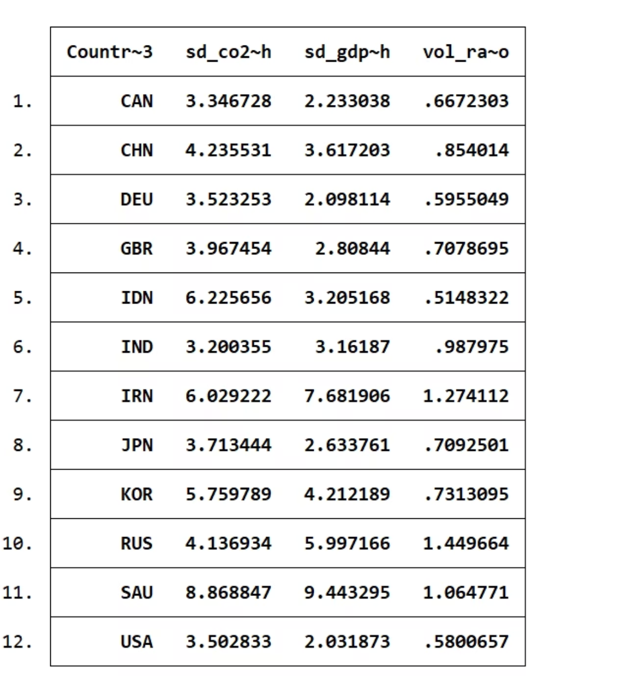
Key Findings: Emissions & GDP Growth
Summary statistics reveal diverse CO₂ growth profiles among the selected countries. China and India show the highest average emissions with strong upward trends, particularly pre-Paris Agreement.
Indonesia, Iran, Korea, Russia, and Saudi Arabia also display high and volatile emissions growth.
In contrast, Germany, the UK, Japan, Canada, and the US exhibit much lower average CO₂ growth, with several cases showing flat or declining emissions post-Paris, even as GDP continues to grow.
CO₂ growth is generally more volatile than GDP growth, especially in Indonesia and Korea. Only Iran, Russia, and Saudi Arabia show GDP growth as more volatile than CO₂ emissions, reflecting their resource-dependent economies.

Slide 9
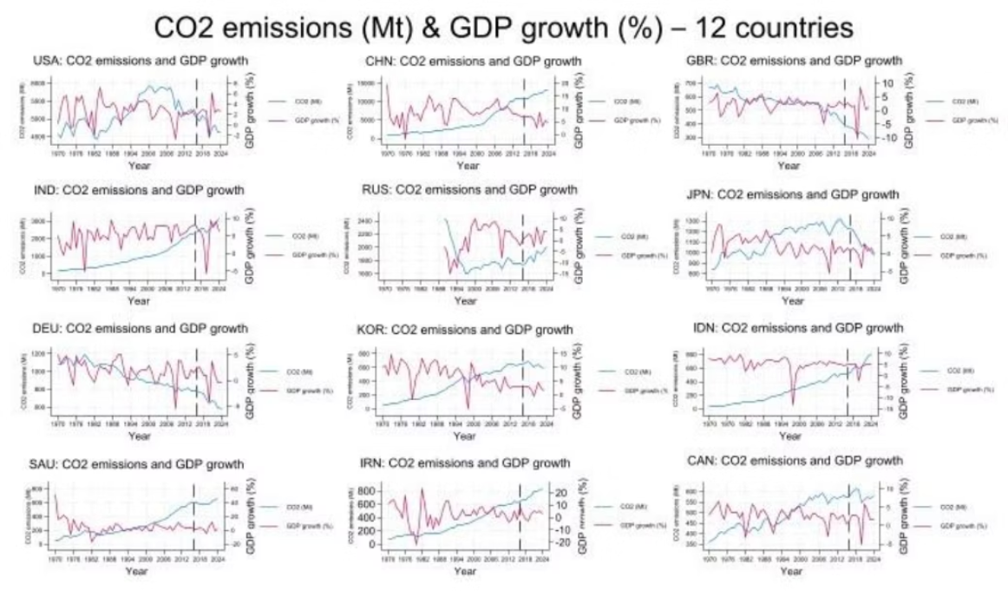
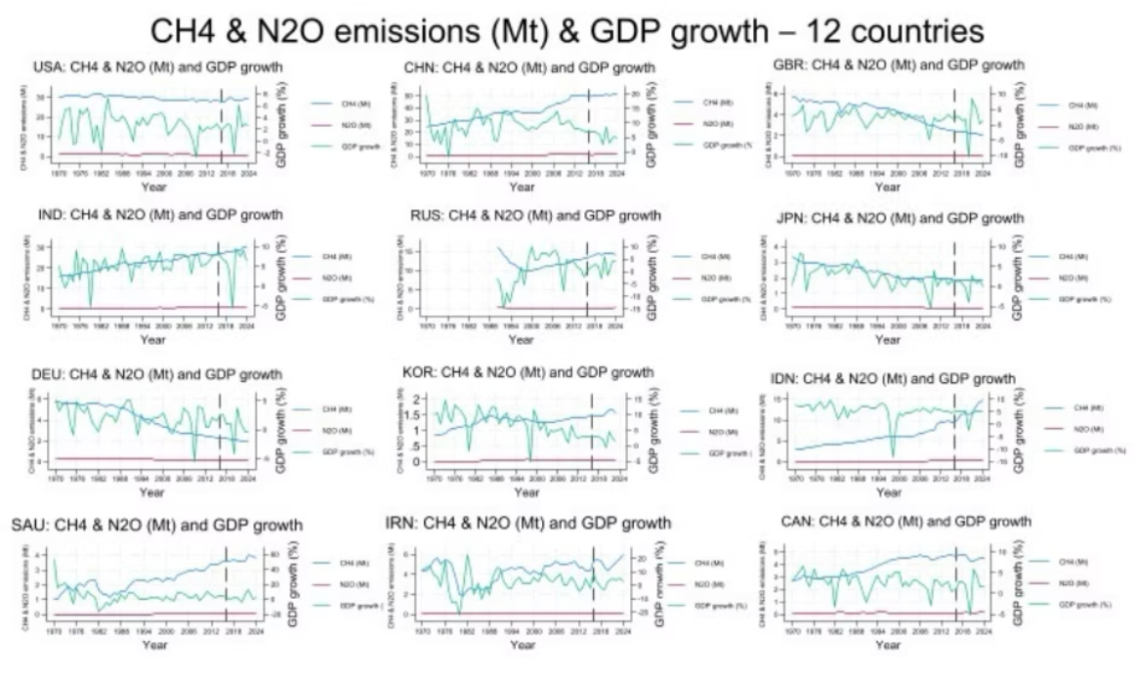
Visualising Decoupling Trends
Time-series graphs plot CO₂ emissions and annual GDP growth on dual y-axes for each country, with a vertical line in 2016 marking the Paris Agreement. These visuals highlight differing dynamics.
The UK and Germany show clear downward CO₂ trends post-2015 despite fluctuating GDP. Japan's emissions peaked in the early 2010s and then fell. India and Russia continue to show steep increases in CO₂.
Meanwhile, CH₄ and N₂O emissions are broadly flat or slowly declining, while annual GDP growth fluctuates strongly. There is no systematic pattern of emissions falling when GDP rises, suggesting methane and nitrous oxide are only weakly linked to short‑run macroeconomic cycles and are driven more by sectoral structures and long‑term policies than by annual growth.
Overall, high-income economies achieve declining or stabilising emissions despite GDP volatility, while many middle- and lower-income countries still experience growing CO₂ emissions alongside economic expansion.

Slide 10
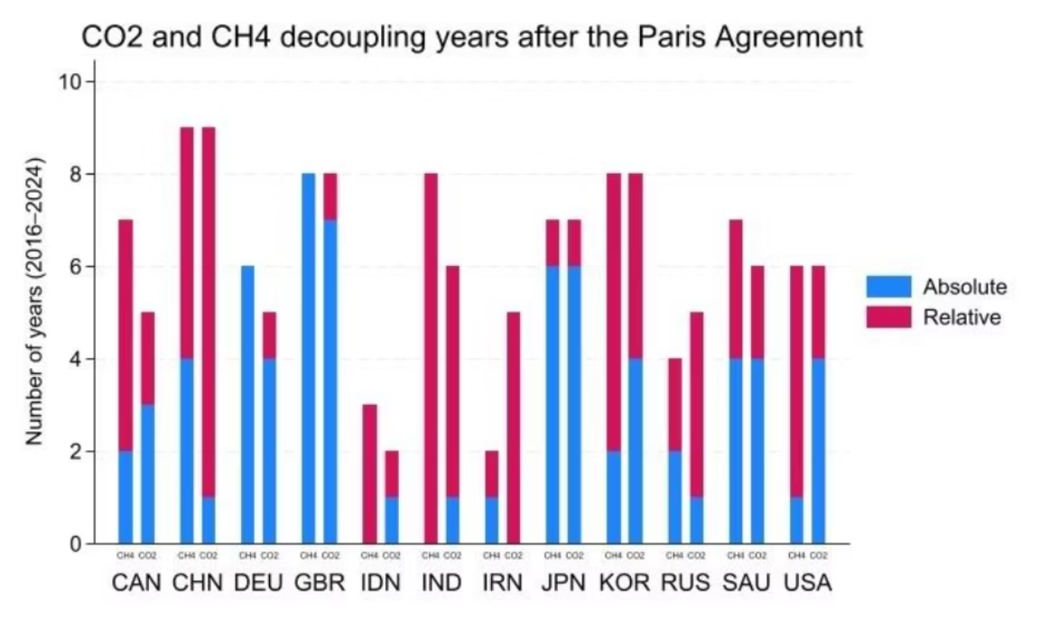
Conclusions & Implications
Emissions continue to rise or plateau after 2016, but the growth rate slowed or decreased drastically compared to the pre-Paris Agreement period. GDP growth remained volatile, with spikes during the 2008 housing crisis and the 2020 Covid-19 pandemic.
Absolute Decoupling
1
Concentrated in a small group of high-income countries post-Paris Agreement.
Policy Reinforcement
2
Highlights the need for direct policies to shift energy mix, raise energy efficiency, and accelerate low-carbon structural change.
Future Research
3
Incorporate energy intensity, sectoral output shares, renewable energy investment, and country-specific policies.
The continued coupling of GDP and emissions highlights challenges in aligning development objectives with strict climate targets.

